Slide 1

SRM INSTITUTE OF SCIENCE AND TECHNOLOGY
Ramapuram, Chennai – 600 089
DEPARTMENT OF COMPUTER SCIENCE AND ENGINEERING – CYBER SECURITY
18CSP109L-PROJECT
ENHANCING THE PREDICTION OF DDoS ATTACK IN IoT NETWORK USING CONTEXT CORRELATION AWARE MODEL
BATCH NUMBER : CSB21
Team Members | Supervisor
Swati Kumari (RA2011030020002) Racharla Rakesh Babu (RA2011030020006) Hitesh Borha (RA2011030020081) | Dr. S. Sathya Priya, Associate Professor/CSE

Slide 2
Agenda
Abstract
Scope and Motivation
Introduction
Literature Survey
Objective
Problem Statement
Proposed Work
  Architecture Diagram
  Modules
  Module Description
Software & Hardware Requirements
Implementation
  Algorithm
  Dataset
Results and Discussion
Conclusion
Future Work
References
Proof of Publication

Slide 3
Abstract
With the widespread integration of Internet of Things (IoT) devices into various domains, ensuring their security has become paramount. Unfortunately, this surge in connectivity has also opened avenues for malicious activities such as Distributed Denial of Service (DDoS) attacks targeting IoT networks. These attacks can disrupt critical services and compromise sensitive data. In response to this growing threat, various methods have been developed to detect and mitigate such attacks. Existing approaches typically rely on signature-based detection, anomaly detection, or machine learning algorithms to identify suspicious activities within IoT networks. However, these methods often struggle to adapt to the dynamic and heterogeneous nature of IoT environments. Moreover, they may generate a high rate of false positives or fail to detect sophisticated attacks. To address these limitations, we propose a novel Context Correlation-Aware Model for enhancing the prediction of DDoS attacks in IoT networks. Our approach leverages contextual information and correlations between different IoT devices and their behaviors to improve the accuracy and efficiency of attack detection. By considering the unique characteristics and relationships within IoT ecosystems, our model aims to provide more robust protection against emerging threats. Through extensive experimentation and evaluation, we demonstrate the effectiveness and scalability of our proposed method in safeguarding IoT networks against DDoS attacks.

Slide 4
Scope
It aims to propose a trust-based approach for mitigating DoS attacks to enhance the security and reliability of IoT systems.
To utilize Random Forest algorithm for classification tasks and context correlation algorithms to refine detection accuracy by analyzing relationships between network parameters.
To analyze the impact of the proposed approach on the performance of the IoT environment and explore potential challenges, limitations associated with the implementation.
This makes machine learning models adaptable to evolving attack patterns through continuous monitoring and updating, ensuring effectiveness against emerging DDoS vectors.
The outcomes of the research is used to enhance the security measures in RPL-based IoT environments and provide more robust defense mechanism against DoS attacks.

Slide 5
Motivation
Distributed Denial of Service (DDoS) attacks are the second most damaging cyberattacks in the ranking published by Bitkom – At 27 percent of total cybersecurity attacks.
(Source URL:https://www2.deloitte.com/content/dam/Deloitte/de/Documents/risk/
Deloitte-DDoS-Cyber-Risk.pdf)
DDoS attacks continue to be a prevalent threat in the cybersecurity landscape.
With the proliferation of Internet-connected devices and the increasing sophistication of attackers, the threat of DDoS attacks is ever-present.
QUAKER SPECIAL RISK – a Jencap company, states that 2021 saw upwards of 9.84 million DDoS attacks, with 73% targeting education, finance, government, and healthcare.(Source : https://www.getastra.com/blog/security-audit/ddos-attack-statistics/)
Engaging in DDoS mitigation initiatives cultivates a culture of ongoing education and adjustment to keep up with changing threats and defensive strategies.

Slide 6
Introduction
IoT is the collective network of connected devices and it is the technology that facilitates communication between devices and the cloud, as well as between the devices themselves.
The Rise of IoT devices has brought about significant advancements and also introduced new security challenges, this includes the threat from DoS and DDoS attacks.
A DoS attack is characterized by using a single computer to launch the attack on the target system.
A DDoS attack is a type of DoS attack that comes from many distributed sources, such as a botnet DDoS attack.
A DoS and DDoS attacks uses malicious attempts to disrupt the normal traffic of a targeted server, service or network by overwhelming the target or its surrounding infrastructure with a flood of Internet traffic beyond its load capacity.
These attacks introduce large response delays, excessive data losses, and service interruptions, resulting in direct impact on availability and integrity of the server.

Slide 7
Introduction
The Existing have difficulty in coping with the massive traffic impact of these attacks on the DNS and this flutter the DNS routing protocols, resulting in disrupting the services and functionality.
The Proposed Model uses a Hybrid learning approach to design and implement a lightweight, double-stage anomaly-based IDS to identify malicious DNS traffic.
The Random Forest algorithm, a powerful machine learning technique, will analyze network traffic features to segregate incoming data packets as normal or malicious with high accuracy.
Context Correlation Algorithm will be employed to analyze the correlation between various network events and identify suspicious patterns indicative of DDoS attacks.
By combining these approaches, organizations can better safeguard their networks, minimize disruptions, and ensure the uninterrupted delivery of services to their users.

Slide 8
Literature Survey
S.No. | Title of the Paper | Year | Journal/Conference Name | Inferences
1. | A Logical Cyber Security Enabled Methodology Design for Identifying Distributed Denial of Service Attacks Using Enhanced Learning Principles | 2023 | ICSCNA | It proposes a logical cybersecurity methodology integrating enhanced learning principles to identify Distributed Denial of Service (DDoS) attacks effectively
2. | Detection and Mitigation of Low-Rate Denial-of-Service Attacks: A Survey | 2022 | IEEE Access | Improved reliability and resilience. Reduces the consumption of hardware resources Tolerates Variations

Slide 9
Literature Survey
S.No. | Title of the Paper | Year | Journal/Conference Name | Inferences
3. | Internet of Things Applications, Security Challenges, Attacks, Intrusion Detection, and Future Visions: A Systematic Review | 2021 | IEEE Access | Ability To Deliver High Quality Results. Minimizes the workload on infrastructures. Performs better on various circumstances and environment.
4. | Signature-Based Traffic Classification and Mitigation for DDoS Attacks Using Programmable Network Data Planes | 2021 | IEEE Access | It provides easy information processing and cost reduction as well. Offer increased flexibility. Quick Calculation Time

Slide 10
Literature Survey
S.No. | Title of the Paper | Year | Journal/Conference Name | Inferences
5. | Towards Crossfire Distributed Denial of Service Attack Protection Using Intent-Based Moving Target Defense Over Software-Defined Networking | 2021 | IEEE Access | Problems are solved on an end-to-end basis. Have Well-Understood Formal Properties. Effectiveness for distributed optimization.
6. | Detection Techniques of Distributed Denial of Service Attacks on Software-Defined Networking ControllerA Review | 2020 | IEEE Access | Boost the Performance. Reduces the resources used for processing purpose. Better operational efficiency.

Slide 11
Literature Survey
S.No. | Title of the Paper | Year | Journal/Conference Name | Inferences
7. | A Survey on Distributed Denial of Service (DDoS) Attacks in SDN and Cloud Computing Environments | 2019 | IEEE Access | Trustworthy and reliable, which refers to obtain explainability. Enhance correlation strength with finer and more compact information. Improve the operational efficiency.
8. | Security Data Collection and Data Analytics in the Internet: A Survey | 2019 | IEEE Communications Surveys & Tutorials | May not meet the real-time requirement. Quick Calculation Time. Minimizes the workload on infrastructures

Slide 12
Literature Survey
S.No. | Title of the Paper | Year | Journal/Conference Name | Inferences
9. | DNS-ADVP: A Machine Learning Anomaly Detection and Visual Platform to Protect Top-Level Domain Name Servers Against DDoS Attacks | 2019 | IEEE Access | Has the best acceptance ratio. Provides the integrity and non transferability. Low Deployment Cost.
10. | Understanding Internet DDoS Mitigation from Academic and Industrial Perspectives | 2019 | IEEE Access | Low Deployment Cost. Achieve sub-optimal performance. Tolerates Variations

Slide 13
Objectives
To implement an enhanced algorithm that reliably detects and classifies DDoS attack in IoT Environment.
To identify vulnerabilities in network infrastructure, web applications, and other online services that could be exploited for DoS and DDoS attacks.
To identify the optimal features from the dataset for evaluation.
To train the model with different datasets to improve the efficiency and accuracy.
To assess the performance of model defense mechanisms and identify any potential weaknesses.
To train the model with normal traffic patterns, anomalous traffic patterns so as to improve the identification of DDoS attacks.

Slide 14
Problem Statement
Existing DDoS detection systems face limitations in keeping up with evolving attack techniques.
These systems often generate false positives or miss subtle attack patterns, leading to network performance degradation.
The proposed approach integrates the Random Forest algorithm and Context Correlation Algorithm.
To generate a Random Forest algorithm that analyzes the network traffic features to segregate packets as normal or malicious with high accuracy.
To generate a Context Correlation Algorithm that identifies coordinated attack behaviors by analyzing contextual information, enhancing the overall resilience of the network against DDoS attacks.

Slide 15
Proposed Work
The Proposed Model uses a two Pronged Approach for analyzing and detecting the DDoS Traffic.
The Random Forest algorithm, a machine learning technique, plays a crucial role by analyzing vast amounts of historical traffic data, both normal and attack-related, the Random Forest learns to identify patterns that differentiate between regular activity and malicious attacks.
The Context Correlation Algorithm considers additional contextual information to build a more comprehensive picture of network activity.
The Factors like imagine traffic originating from unusual geographical locations, sudden spikes in traffic volume, or coordinated attack patterns from multiple sources are considered by context correlation algorithm.
By correlating these contextual factors, the system can effectively identify complex attack behaviors that affects the IoT devices.

Slide 16
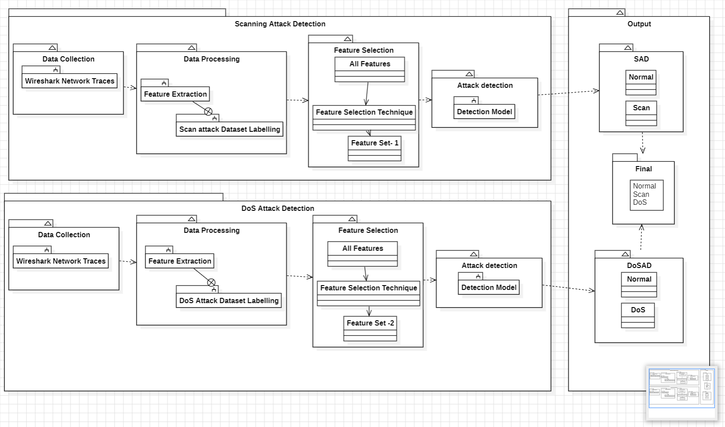
Architecture diagram
Figure 1 Architecture Diagram

Slide 17
Modules
There are Seven modules:
Module 1: Data Pre-processing
Module 2: Feature Selection
Module 3: Class Imbalance
Module 4: Model Training
Module 5: Random Forest Algorithm
Module 6: Classification
Module 7: Performance Evaluation

Slide 18
Modules
Module 1: Data Pre-processing
This includes the following steps:
Data cleaning: Fill in missing values, eliminate redundant or unnecessary data, and standardize data formats.
Missing value imputation: This technique substitutes useful estimations, like a function's mean or a forecast from a different model, for missing data.
Data scaling: Adjust the data to ensure that the range of values for each feature is the same.
Feature selection: Only include the features that are most crucial to the model's ability to reduce precise predictions.
Data Splitting: The preprocessed data is then divided into training, validation, and test sets. The model learns from the training set, is fine-tuned on the validation set, and its generalizability is evaluated on the unseen test set.

Slide 19
Modules
Module 2: Feature Selection
Feature Selection is used mainly to reduce dimensionality of data set for improving network traffic analysis.
A subset of the most significant or practical features from the raw data is chosen through the process of feature selection.
The Filtered features are then used to train the model and also for next stage of processing of the data.
Enhancing the precision, interpretability, computational efficiency, and generalizability of machine learning algorithms is the goal of feature selection.

Slide 20
Modules
Module 3: Class Imbalance
Unequal class balance is a common problem in real ML practice.
Imbalanced classes in machine learning data can cause models to be biased towards the majority class, leading to unreliable results for the minority class.
Detection of class imbalance is crucial and can be done through statistical analysis and data visualization.
Data augmentation techniques like resampling can help create a more balanced dataset and improve model performance. These techniques can also help to improve the generalization of the model to unseen data.

Slide 21
Modules
Module 4: Model training
The process involves meticulous data allocation, with 75% dedicated to rigorous training and 25% reserved for thorough testing.
This balanced approach ensures the model's proficiency in recognizing known anomalies while adapting to unforeseen scenarios.
This process mirrors a detective analysing crime patterns, learning from historical data to promptly potential threats.
As the training unfolds, the system immerses itself in the intricacies of DDoS behaviors, drawing insights from past incidents to anticipate future attacks

Slide 22
Modules
Module 5: Random Forest algorithm
The Random Forest algorithm is a robust ML technique widely employed for classification and regression tasks. Its strength lies in ensemble learning, where numerous decision trees are created and combined to form a stronger predictive model.
Every decision tree is built using random subsets of the training data and features, reducing overfitting and enhancing generalization.
In DDoS attacks, Random Forest excels in identifying crucial features such as network traffic patterns and packet characteristics.
Its ensemble nature ensures resilience against noise and outliers in data, crucial for cybersecurity datasets often fraught with irregularities.

Slide 23
Modules
Module 6: Classification
In the classification stage, the extracted features and contextual information are analyzed to identify patterns indicative of DDoS attacks.
Context correlation involves examining how different features and contextual factors relate to each other and to the occurrence of DDoS attacks.
Contextual information provides insight into the behavior of network traffic. This could include temporal information (e.g., time of day, day of the week), spatial information (e.g., geographical location), historical information (e.g., past traffic patterns), and protocol-specific information (e.g., HTTP request methods for web traffic).
Context Correlation enhances the accuracy and effectiveness of DDoS detection systems by considering not only individual features of network traffic but also their relationships and contextual relevance.
This enables more precise identification of anomalous behavior associated with DDoS attacks while reducing false positives.

Slide 24
Software & Hardware Requirements
Hardware Requirements :
Processor: Minimum i5 Dual Core
Ethernet connection (LAN) OR a wireless adapter (Wi-Fi)
Hard Drive: Minimum 200 GB; Recommended 200 GB or more.
Memory (RAM): Minimum 16 GB; Recommended 32 GB or above)

Slide 25
Software & Hardware Requirements
Software Requirements :
Python For AI/ML/DL Programming
Jupyter Notebook IDE (Integrated Development Environment) for Development.
Sklearn for Machine Learning/Feature Extraction/Evaluation Metrics Coding.
Numpy for implementing Linear Algebra.
Plotly for Data Visualization (For Graphs).
Matplotlib for Data Visualization (For Graphs).
Seaborn for Data Visualization (For Graphs).
Pandas for dealing with Tabular Data.

Slide 26
Implementation
Algorithm:
Step 1: Data Acquisition and Preprocessing
  Obtain the raw dataset containing network traffic features and the target variable (e.g., DNS server requests, source IP addresses, request types).Normalize the features in the dataset using techniques like min-max normalization or f-score normalization . Apply feature scaling to ensure all features have a similar range.
Step 2: Feature Selection
  Train a Random Forest model on the preprocessed dataset to identify important features. Obtain feature importance scores from the Random Forest model. Select the most important features based on the feature importance scores.

Slide 27
Implementation
Step 3: Data Splitting
  Split the preprocessed dataset into a training set and a test set . Extract the selected features from both the training and test sets.
Step 4: Model Training
  Choose a regression algorithm for contextual correlation modeling. Train the chosen regression model using the training set and selected features. Store the trained contextual correlation model.
Step 5: Model Evaluation
  Extract the selected features from the test set. Use the trained contextual correlation model to predict the expected behavior of DNS server requests. Calculate evaluation metrics by comparing the predicted behavior with the actual DNS server requests.

Slide 28
Implementation
Step 6: Network Traffic Anomaly Detection
  Preprocess the new data using the same normalization and scaling techniques as in Step 1. Extract the selected features from the preprocessed new data. Use the trained Random Forest model to identify anomalies in the network traffic features. Use the trained contextual correlation model to verify if the identified anomalies align with expected behavior. If anomalies are detected and verified, take appropriate actions .
Step 7: Model Retraining
  Obtain a new dataset containing the latest network traffic data. Repeat Steps 1 to 4 using the new dataset to retrain the models. Evaluate the retrained models on a separate test set (repeat Step 5). Deploy the retrained models for network traffic anomaly detection (repeat Step 6).

Slide 29
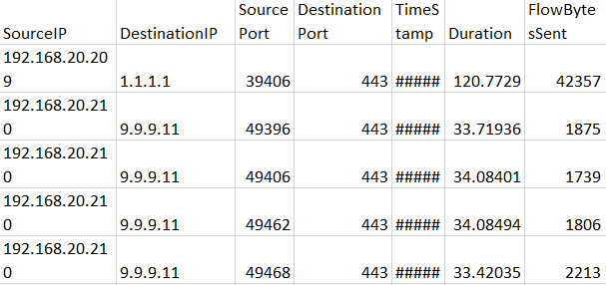
Implementation
Data set:
Figure 2 Data set
Source IP Address: The source IP address refers to the numerical label assigned to devices (such as computers or servers) within a network that originates the data packets. It identifies the sender or originator of the network traffic.

Slide 30
Implementation
Destination IP Address: The destination IP address represents the numerical label assigned to devices within a network that receives the data packets. It identifies the intended recipient or destination of the network traffic.
Source Port: The source port is a numeric identifier associated with the application or service on the sending device that generates the network traffic. It helps in distinguishing between different communication channels or processes on the sender's end.
Destination Port: The destination port is a numeric identifier associated with the application or service on the receiving device that listens for incoming network traffic. It assists in routing the data packets to the appropriate application or service on the recipient's end.
Timestamp: The timestamp indicates the date and time when the network traffic occurred. It provides temporal information about when the data packets were transmitted or received, which is crucial for analyzing traffic patterns and identifying anomalies over time.

Slide 31
Results and Discussion
The Combination of Random Forest and Context Correlation algorithm is developed successfully for the proposed system.
In Data preprocessing the DNS data traffic is successfully filtered and splitted to train and work on the anomaly detection.
The Random Forest and Context correlation algorithms have processed the data and are able to identify and correlate the similarities from the traffic.
The proposed model is able to segregate the DNS Traffic into Malicious and Non – malicious traffic successfully.
The analysis shows that the training loss score values are high during the first three training epochs.
With the increase in the number of epochs, the loss scores are decreased, and the accuracy scores are increased.

Slide 32
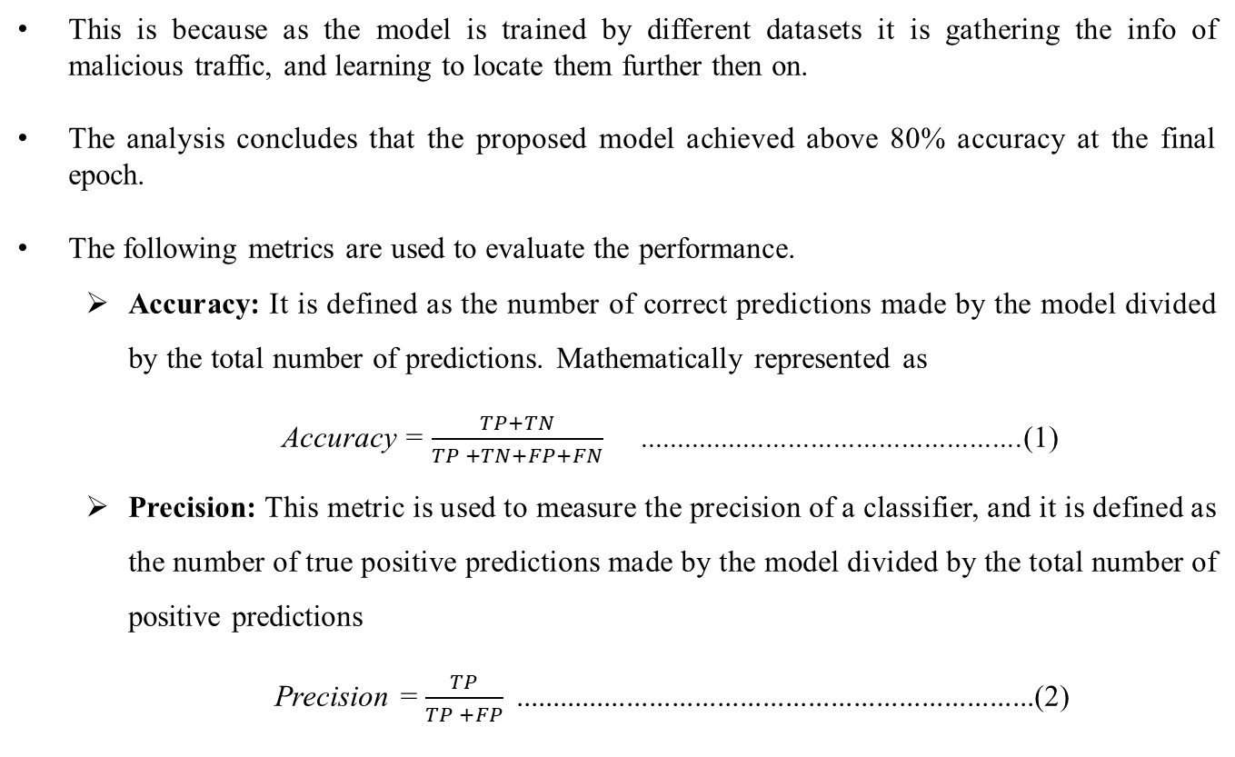
Results and Discussion
This is because as the model is trained by different datasets it is gathering the info of malicious traffic, and learning to locate them further then on.
The analysis concludes that the proposed model achieved above 80% accuracy at the final epoch.
The following metrics are used to evaluate the performance.
  Accuracy: It is defined as the number of correct predictions made by the model divided by the total number of predictions. Mathematically represented as
  Accuracy = $\frac{TP+TN}{TP +TN+FP+FN}$ ...................................................(1)
  Precision: This metric is used to measure the precision of a classifier, and it is defined as the number of true positive predictions made by the model divided by the total number of positive predictions
Precision = $\frac{TP}{TP +FP}$.....................................................................(2)

Slide 33
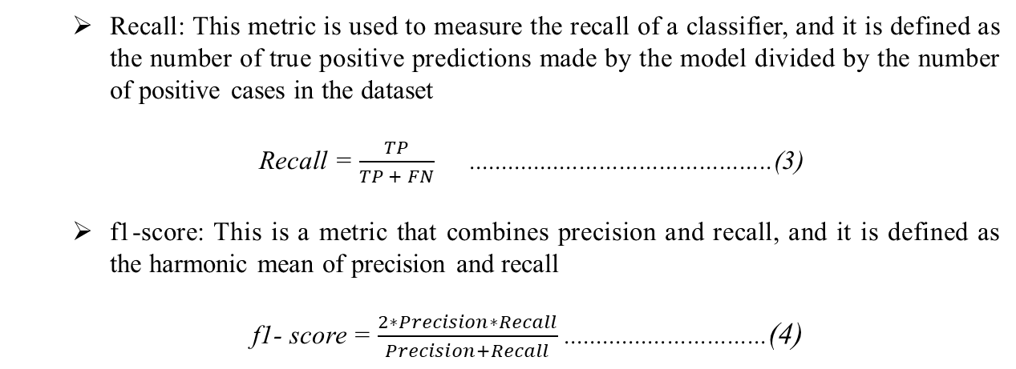
Results and Discussion
  Recall: This metric is used to measure the recall of a classifier, and it is defined as the number of true positive predictions made by the model divided by the number of positive cases in the dataset
Recall = $\frac{TP}{TP + FN}$..............................................(3)
  f1-score: This is a metric that combines precision and recall, and it is defined as the harmonic mean of precision and recall
f1- score = $\frac{2∗Precision∗Recall}{Precision+Recall}$ ...............................(4)
Table 1. Comparison of the Implementations
Model | Accuracy | F Score | Precision | Recall
( Random Forest + Context Correlation ) Classifier | 0.80 | 0.81 | 0.84 | 0.79
Hist Gradient Boosting Classifier | 0.50 | 0.42 | 0.44 | 0.47
Ada Boost Classifier | 0.50 | 1 | 0.66 | 0.49

Slide 34
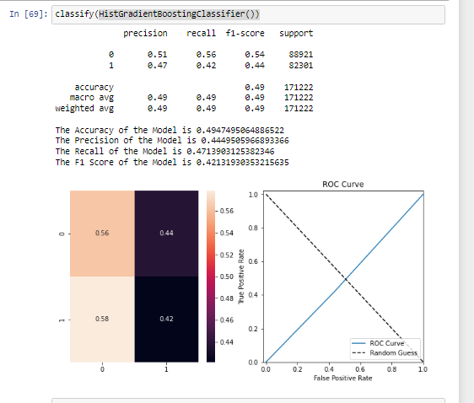
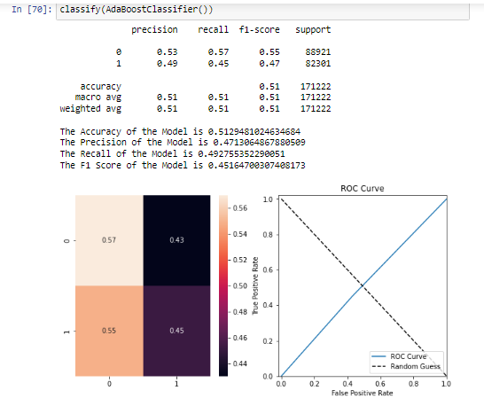
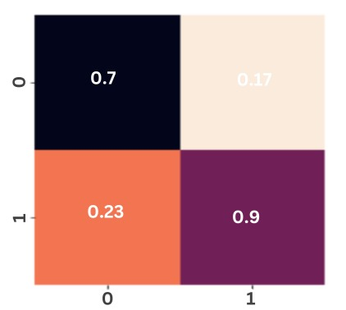
Results and Discussion
Figure 2. Hist Gradient Boosting
Figure 3. Adaboost Classifier
Figure 4. ( Random Forest + Context Correlation ) Classifier
The ( Random Forest + Context Correlation ) Classifier is the most accurate out of the three classifiers, with accuracy score of 0.80.
It's important to note that F1-Score is a way of measuring a model on both precision and recall. In this case, even though Adaboost has the highest F1-Score, it is because it favors recall over precision, since it has a higher recall value and a lower precision value compared to Random Forest.

Slide 35
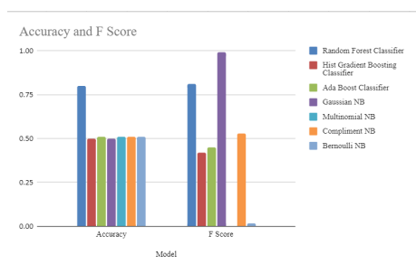
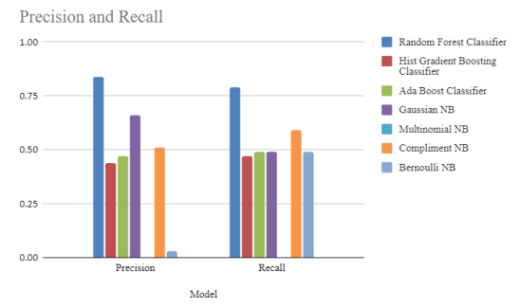
Results and Discussion
Random Forest + Context Correlation
Figure 5 Accuracy and F score Graph
Figure 6 Precision and Recall Graph

Slide 36
Conclusion
This proposes a novel method for detecting DDoS attacks in IoT networks, leveraging feature engineering and machine learning techniques.
By analyzing incoming network traffic, the study identifies significant variations in feature characteristics, crucial for distinguishing attackers, suspects, and authentic clients.
A systematic approach is employed to explore all possible combinations of attack features, resulting in a structured framework for effective threat differentiation.
Furthermore, it delves into various methods dedicated to detecting DDoS attacks targeting IoT networks, reflecting a comprehensive exploration of the contemporary challenges and solutions in mitigating such cyber threats.
This research presents a promising avenue for enhancing the resilience of IoT networks against DDoS attacks through innovative detection methodologies and rigorous experimental validation.

Slide 37
Future Work
In the forthcoming endeavors, the proposed model is used to elevate and broaden the existing methodologies for detecting DDoS attacks.
This entails harnessing advanced feature-engineering techniques and machine learning models, particularly Deep Learning, to enhance the performance and accuracy of classifiers.
By delving into sophisticated approaches, proposed model strive to refine the system's ability to discern subtle patterns indicative of DDoS activity, thereby bolstering its effectiveness in threat detection.
Furthermore, this research will delve into strategies for mitigating adversarial attacks, fortifying the method's robustness and adaptability in dynamic network environments.

Slide 38
References
[1] | Yuan Cao, Yuan Gao, Rongjun Tan, Qingbang Han and Zhuotao Liu, “Understanding Internet DDoS Mitigation from Academic and Industrial Perspectives”, IEEE Access, Volume 6, 2018.
[2] | Luis A. Trejo, Victor Ferman, Miguel Angel Medina-pérez, Fernando Miguel Arredondo Giacinti, Raúl Monroy, And Jose E. Ramirez-marquez, “DNS-ADVP: A Machine Learning Anomaly Detection and Visual Platform to Protect Top-Level Domain Name Servers Against DDoS Attacks”, IEEE Access, VOLUME 7, 2019.
[3] | Xuyang Jing, Zheng Yan and Witold Pedrycz, “Security Data Collection and Data Analytics in the Internet: A Survey”, IEEE Communications Surveys & Tutorials, Vol. 21, No. 1, First Quarter 2019.
[4] | Qiao Yan, F. Richard Yu, Senior Member, IEEE, Qingxiang Gong, and Jianqiang Li, “Software-Defined Networking (SDN) and Distributed Denial of Service (DDoS) Attacks in Cloud Computing Environments: A Survey, Some Research Issues, and Challenges”, IEEE Communications Surveys & Tutorials, Vol. 18, No. 1, First Quarter 2016.
[5] | Mohammad A. Aladaileh , Mohammed Anbar, Iznan H. Hasbullah , Yung-wey Chong, And Yousef K. Sanjalawe, “Detection Techniques of Distributed Denial of Service Attacks on Software-Defined Networking Controller–A Review”, IEEE Access, Volume 8, 2020.

Slide 39
References
[6] | Muhammad Faraz Hyder and Tasbiha Fatima, “Towards Crossfire Distributed Denial of Service Attack Protection Using Intent-Based Moving Target Defense Over Software-Defined Networking”, Digital Object 10.1109/ACCESS.2021.3103845 , IEEE Access, Volume 9, 2021.
[7] | Marinos Dimolianis, Adam Pavlidis , and Vasilis Maglaris, “Signature-Based Traffic Classification and Mitigation for DDoS Attacks Using Programmable Network Data Planes”, IEEE ACCESS, Volume 9, 2021.
[8] | Nivedita Mishra and Sharnil Pandya, “Internet of Things Applications, Security Challenges, Attacks, Intrusion Detection, and Future Visions: A Systematic Review”, IEEE Access, Volume 8, 2021.
[9] | Vinícius De Miranda Rios, Pedro R. M. Inácio, Damien Magoni and Mário M. Freire, “Detection and Mitigation of Low-Rate Denial-of-Service Attacks: A Survey”, IEEE ACCESS, Volume 10, 2022
[10] | Matteo Repetto , Gianmarco Bruno , Jalolliddin Yusupov , Guerino Lamanna , Benjamin Ertl , and Alessandro Carrega, “Automating Mitigation of Amplification Attacks in NFV Services”, IEEE Transactions On Network And Service Management, Vol. 19, No. 3, September 2022.

Slide 40
References
[11] | Farag Azzedin, “Mitigating Denial of Service Attacks in RPL-Based IoT Environments: Trust-Based Approach”, IEEE Access, Volume 11, 2023.
[12] | R. Karthiga; Praveen Kumar E; S Kumari; Kala Priyadarshini G; V. Sureka; V Samuthira Pandi,”A Logical Cyber Security Enabled Methodology Design for Identifying Distributed Denial of Service Attacks Using Enhanced Learning Principles”, International Conference on Sustainable Communication Networks and Application(ICSCNA), 2023.
[13] | Mohammed Amine Boudouaia; Abdelhafid Abouaissa; Ayoub Benayache; Pascal Lorenz, “Divide and Conquer-based Attack against RPL Routing Protocol” , IEEE Global, 2021.
[14] | Raveendranadh Bokka; Tamilselvan Sadasivam, “DIS flooding attack Impact on the Performance of RPL Based Internet of Things Networks: Analysis” , IEEE Access, 2021.
[15] | Sonam Goyal; Trilok Chand, “Improved Trickle Algorithm for Routing Protocol for Low Power and Lossy Networks”, IEEE Access, Volume 18, 2017.
[16] | Source URL: www2.deloitte.com/content/dam/Deloitte/de/Documents/risk/Deloitte-DDoS-Cyber-Risk.pdf accessed on 26/02/2024.
[17] | Source URL: https://www.getastra.com/blog/security-audit/ddos-attack-statistics accessed on 26/02/2024.

Slide 41
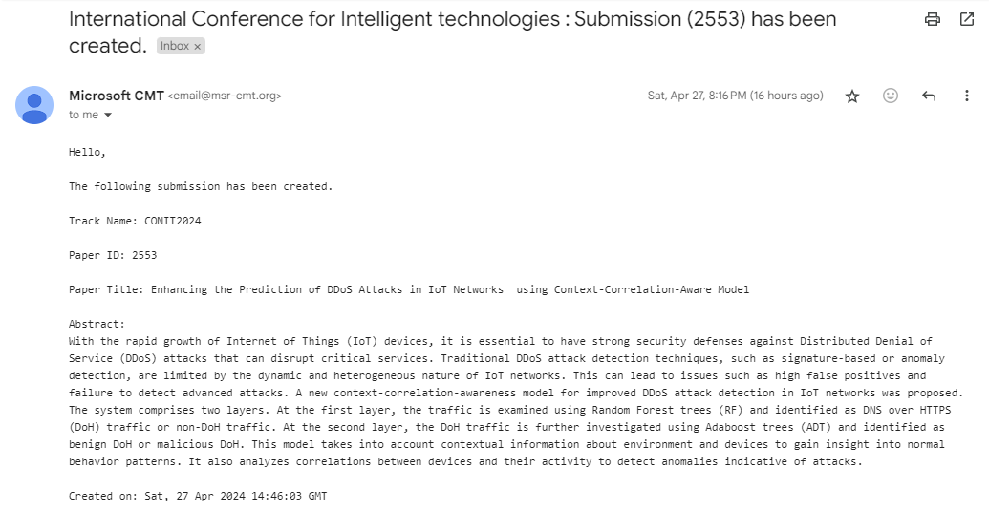
Proof of Publication

Slide 42
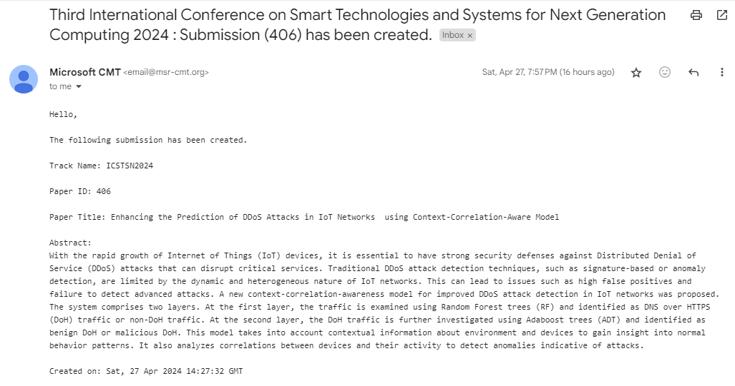
Proof of Publication

